Slide 1
Chapter 13
Binomial Trees

Slide 2
A Simple Binomial Model
A stock price is currently $20
In 3 months it will be either $22 or $18
Stock Price = $22
Stock price = $20
Stock Price = $18

Slide 3
A Call Option (Figure 13.1)
A 3-month call option on the stock has a strike price of 21.
Stock Price = $22
Option Payoff = $1
Stock price = $20
Option Price=?
Stock Price = $18
Option Payoff = $0

Slide 4
Setting Up a Riskless Portfolio
For a portfolio that is long Δ shares and a short 1 call option values are
Portfolio is riskless when 22Δ – 1 = 18Δ or Δ = 0.25
22Δ – 1
18Δ

Slide 5
Valuing the Portfolio
(Risk-Free Rate is 4%)
The riskless portfolio is:
long 0.25 shares
short 1 call option
The value of the portfolio in 3 months is
22 ⋅0.25 – 1 = 4.50
The value of the portfolio today is
4.5e^{–0.04⋅0.25} = 4.455

Slide 6
Valuing the Option
The portfolio that is
long 0.25 shares
short 1 option
is worth 4.455
The value of the shares is 5.000 (= 0.25 ⋅ 20 )
The value of the option is therefore
5.000 – 4.455 = 0.545

Slide 7
Generalization (Figure 13.2)
A derivative lasts for time T and is dependent on a stock
S₀u
ƒ_{u}
S₀
ƒ
S₀d
ƒ_{d}

Slide 8
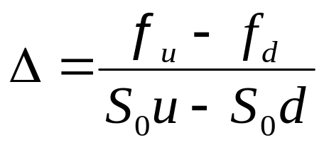
Generalization (continued)
Value of a portfolio that is long Δ shares and short 1 derivative:
The portfolio is riskless when S₀uΔ – ƒ_{u} = S₀dΔ – ƒ_{d} or
S₀uΔ – ƒ_{u}
S₀dΔ – ƒ_{d}

Slide 9
Generalization (continued)
Value of the portfolio at time T is S₀uΔ – ƒ_{u}
Value of the portfolio today is (S₀uΔ – ƒ_{u})e^{–rT}
Another expression for the portfolio value today is S₀Δ – f
Hence
ƒ = S₀Δ – (S₀uΔ – ƒ_{u} )e^{–rT}

Slide 10
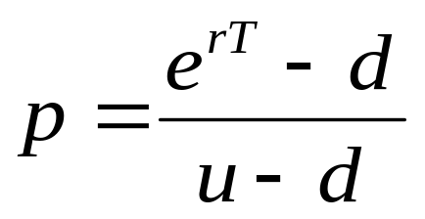
Generalization continued (equation 13.2 and 13.3)
Substituting for Δ we obtain
ƒ = [ pƒ_{u} + (1 – p)ƒ_{d} ]e^{–rT}
where

Slide 11
p as a Probability
It is natural to interpret p and 1-p as probabilities of up and down movements
The value of a derivative is then its expected payoff in a risk-neutral world discounted at the risk-free rate
S₀u
ƒ_{u}
p
S₀
ƒ
S₀d
ƒ_{d}
(1 – p )

Slide 12
Risk-Neutral Valuation
When the probability of an up and down movements are p and 1-p the expected stock price at time T is S₀e^{rT}
This shows that the stock price earns the risk-free rate
Binomial trees illustrate the general result that to value a derivative we can assume that the expected return on the underlying asset is the risk-free rate and discount at the risk-free rate
This is known as using risk-neutral valuation

Slide 13
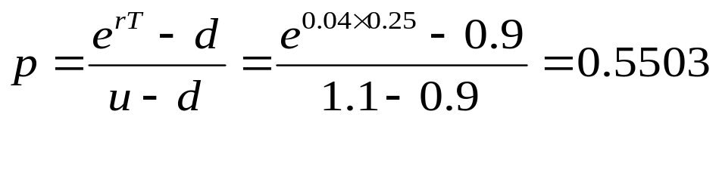
Original Example Revisited
p is the probability that gives a return on the stock equal to the risk-free rate:
20e ^{0.04 ⋅0.25} = 22p + 18(1 – p ) so that p = 0.5503
Alternatively:
S₀u = 22
ƒ_{u} = 1
p
S₀=20
ƒ
(1 – p )
S₀d = 18
ƒ_{d} = 0

Slide 14
Valuing the Option Using Risk-Neutral Valuation
The value of the option is
e^{–0.04⋅0.25} (0.5503 ⋅1 + 0.4497⋅0)
= 0.545
S₀u = 22
ƒ_{u} = 1
0.5503
S₀=20
ƒ
0.4497
S₀d = 18
ƒ_{d} = 0

Slide 15
Irrelevance of Stock’s Expected Return
When we are valuing an option in terms of the price of the underlying asset, the probability of up and down movements in the real world are irrelevant
This is an example of a more general result stating that the expected return on the underlying asset in the real world is irrelevant

Slide 16
A Two-Step Example
Figure 13.3
K=21, r = 4%
Each time step is 3 months
24.2
22
20
19.8
18
16.2

Slide 17
Valuing a Call Option
Figure 13.4
Value at node B
= e^{–0.04⋅0.25}(0.5503⋅3.2 + 0.4497⋅0) = 1.7433
Value at node A
= e^{–0.04⋅0.25}(0.5503⋅1.7433 + 0.4497⋅0) = 0.9497
24.2
3.2
22
B
20
0.9497
1.7433
19.8
0.0
A
18
0.0
16.2
0.0

Slide 18
A Put Option Example
Figure 13.7
72
0
60
50
4.1923
1.4147
48
4
40
9.4636
32
20
K = 52, time step =1yr
r = 5%, u =1.2, d = 0.8, p = 0.6282

Slide 19
What Happens When the Put Option is American (Figure 13.8)
72
0
60
50
5.0894
1.4147
48
4
40
The American feature increases the value at node C from 9.4636 to 12.0000.
This increases the value of the option from 4.1923 to 5.0894.
C
12.0
32
20

Slide 20
Delta
Delta (Δ) is the ratio of the change in the price of a stock option to the change in the price of the underlying stock
The value of Δ varies from node to node

Slide 21
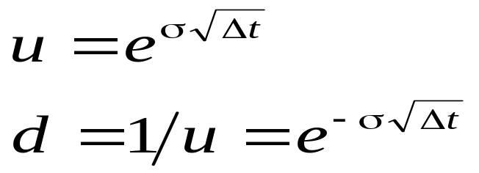
Choosing u and d (equations 13.15 and 13.16)
One way of matching the volatility is to set
where σ is the volatility and Δt is the length of the time step. This is the approach used by Cox, Ross, and Rubinstein

Slide 22
Girsanov’s Theorem
Volatility is the same in the real world and the risk-neutral world
We can therefore measure volatility in the real world and use it to build a tree for the an asset in the risk-neutral world

Slide 23
Assets Other than Non-Dividend Paying Stocks
For options on stock indices, currencies and futures the basic procedure for constructing the tree is the same except for the calculation of p

Slide 24
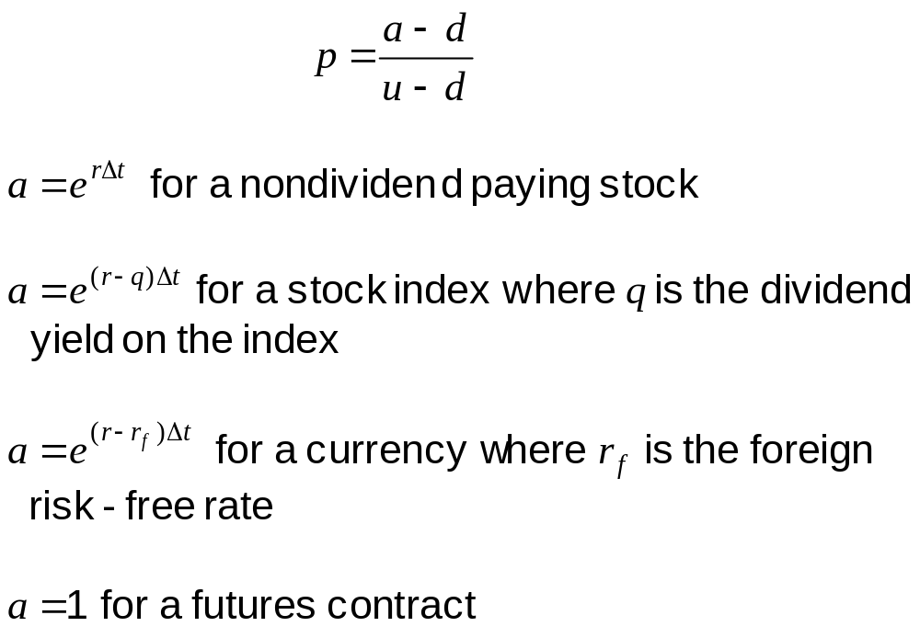
The Probability of an Up Move

Slide 25
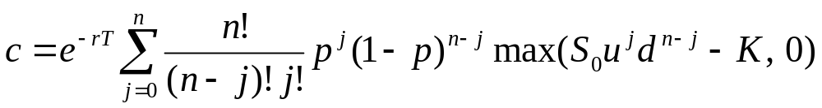
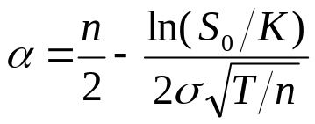
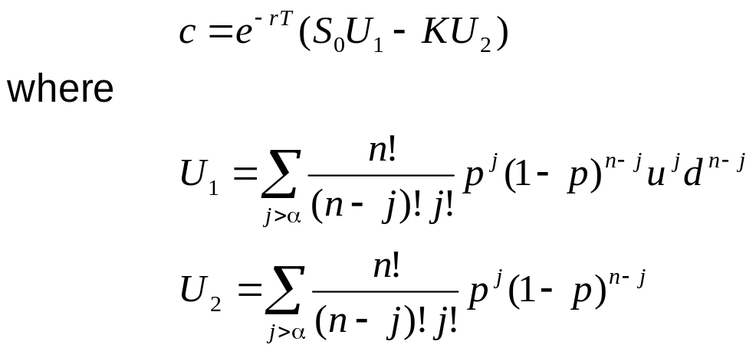
Proving Black-Scholes-Merton from Binomial Trees (Appendix to Chapter 13)
Option is in the money when j > α where
so that

Slide 26
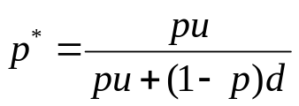
Proving Black-Scholes-Merton from Binomial Trees continued
The expression for U₁ can be written
where
Both U₁ and U₂ can now be evaluated in terms of the cumulative binomial distribution
We now let the number of time steps tend to infinity and use the result that a binomial distribution tends to a normal distribution

